Slide 1
MOHR GAC Transportation 2023

Slide 2
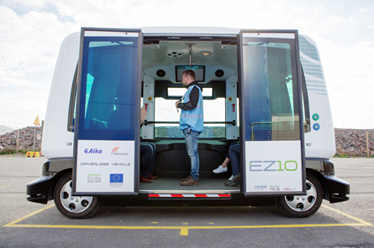
AGENDA
MOHR’s Transportation Subcommittee
Current Year’s Priorities & Intended Deliverables
Cross-Coordination Activities
Reminder – Market Rate Tools Available
Questions, Concerns & Recommendations
MOHR GAC Transportation Subcommittee Members:
Mike Greenbaum, Newtrax
Elizabeth Schear, Advance
Jennifer Freeburg, N.E. Contemporary Services
Ryan Nelson, Rise
Tim Schmutzer, PHASE-Industries
Lori Schluttenhofer, Opportunity Partners
Hope Donald, Opportunity Partners
Karen Herman, Udac
Ann Dahl, Udac
Nova Senarighi, Udac
Jim Rooker, Achieve Services
Bob Platz, Lifeworks

Slide 3
Transportation Subcommittee Priorities & Intended deliverables
Priority #1
Develop & provide MOHR Member assistance in accurately capturing & reporting in-program transportation costs via DWRS cost reporting.
Deliverable #1: Provide MOHR Membership in-person and/or virtual training on accurately and efficiently capturing in-program transportation-related expenses to populate in the appropriate sections of the DHS DWRS Cost Reporting Template.
Action Update on Deliverable #1: Group originally scheduled to present training at 2023 MOHR Legislative Conference, but because DHS is providing Cost Reporting Training, the Transportation Subcommittee will offer its training in late fall/early winter, supplementing the guidance provided by DHS at the Legislative Conference.

Slide 4
Transportation Subcommittee Priorities & Intended deliverables
Priority #2
Following from Priority #1, update transportation survey data to ensure MOHR has an up-to-date framework & values for arriving at the true cost of providing in-program transportation.
Deliverable #2: Provide MOHR Membership in-person and/or virtual training on accurately and efficiently capturing in-program transportation-related expenses to populate in the appropriate sections of the DHS DWRS Cost Reporting Template.
Action Update on Deliverable #2: Working through extracting MOHR Survey Data and applying current day cost formulas to arrive at an average per trip, per mile, per hour in-program transportation cost, differentiated by geographic region and type of vehicle. NOTE: we do not have raw data that identifies mobility-assist trips versus ambulatory trips→ this is data we would like to collect in future.

Slide 5
Transportation Subcommittee Priorities & Intended deliverables
Priority #3
Priority #3, Create & maximize a (MOHR member) position of influence & impact within Met Council’s strategic change.
Deliverable #3: Protect PCTS (Person Centered Transportation Supports), coordination supports & associated reimbursement mechanisms, while promoting improvements in operational capacities of accessible transportation options.
Action Update on Deliverable #2: Subcommittee collected testimonials on rider and provider experiences with Metro Mobility. Mike Greenbaum is using these to influence the decision-makers within Met Council & Metro Mobility.
While this priority area is currently limited to the metro area, what’s happening within Met Council may have implications in the future across the state. MOHR’s intent is to influence this system change at the ground level.

Slide 6
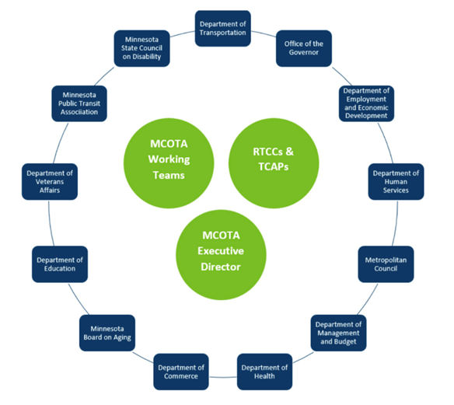
Cross organizational activities
MOHR Coordinating with MCOTA: The Minnesota Council on Transportation Access (MCOTA) was established by the Minnesota Legislature in 2010 (Minn. Statute 2010 174.285) to "study, evaluate, oversee, and make recommendations to improve the coordination, availability, accessibility, efficiency, cost-effectiveness, and safety of transportation services provided to the transit public."
MCOTA has several working groups, on which MOHR has representation. Some of the key priorities within these groups include:
Ensure that people with behavioral and accessibility challenges have meaningful access and are involved in planning;
Reduce barriers to sharing vehicles, including providing incentives to these providers to both share their vehicles with others and provide more individualized transportation services in their region to non-client populations.
Identify ways of improving the effectiveness, accessibility and reach of rural transportation as well as researching different types of modeling are important to improving and reforming in how rural transportation is delivered.
De-mystify current confusion and lack of consistent information regarding waivered services reimbursement; lack of communication between DHS and providers.
[Determine] accurate market rates for reimbursements (in negotiating with counties/funders); need to account for increased costs (include a fuel escalator in contract as well as different mode rates).

Slide 7
Reminder on provider resource
Provider Resource Packet – MOHR Transportation Rate Tool & Sample Letter Template from Provider to Lead Agency (last updated 8/22). See Conference Materials link on MOHR website for packet.

Slide 8
Questions & Discussion
Questions:
Concerns:
Recommendations:

Slide 9
resources
If providers experience difficulty obtaining a market rate from lead agencies, consistent with the direction and guidelines provided by DHS, the provider should email DHS at dsd.rates@state.mn.us for assistance.
Final DHS (Navigant) Legislative Report on Access to Waiver Transportation Used by MN’s HCBS Program Participants. https://www.leg.state.mn.us/docs/2019/mandated/190532.pdf
CBSM Description of “Market Rate” Services https://www.dhs.state.mn.us/main/idcplg?IdcService=GET_DYNAMIC_CONVERSION&RevisionSelectionMethod=LatestReleased&dDocName=dhs-307949#
CBSM Briefcase resource document: Transportation and day and employment services- https://www.dhs.state.mn.us/main/idcplg?IdcService=GET_DYNAMIC_CONVERSION&RevisionSelectionMethod=LatestReleased&dDocName=dhs-305044#
CBSM Transportation Page: https://www.dhs.state.mn.us/main/idcplg?IdcService=GET_DYNAMIC_CONVERSION&RevisionSelectionMethod=LatestReleased&dDocName=id_002204#

