Slide 1
National Policy Trends Impacting Providers and Services for People with I/DD
Lydia Dawson, Vice President of Government Relations

Slide 2
Federal Policy Trends
Strengthening community integration and home and community-based services
Supporting the direct care workforce
Ensuring greater Medicaid eligibility and beneficiary protections
Focus areas: Access Rule, Overtime Rule, and other rulemaking.

Slide 3

Strengthening HCBS
Introduction of several pieces of legislation seeking to strengthen HCBS:
Better Care Better Jobs Act
HCBS Access Act
HCBS Relief Act
Disability Community Act

Slide 4

Strengthening HCBS
Renewed administrative focus on HCBS:
$150B for HCBS in President’s budget blueprint
New regulations focused on access, eligibility, and streamlining authorizations
This Photo by Unknown Author is licensed under CC BY-NC

Slide 5
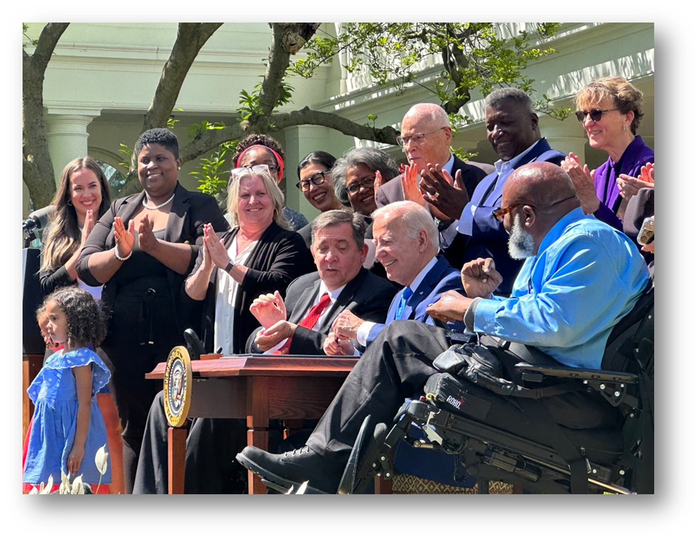
Supporting the Direct Care Workforce
Biden Administration Recognition:
Executive Order on Caregiving
State of the Union address
Care Workers Recognition Month
Recognition of workforce crisis in rulemaking

Slide 6
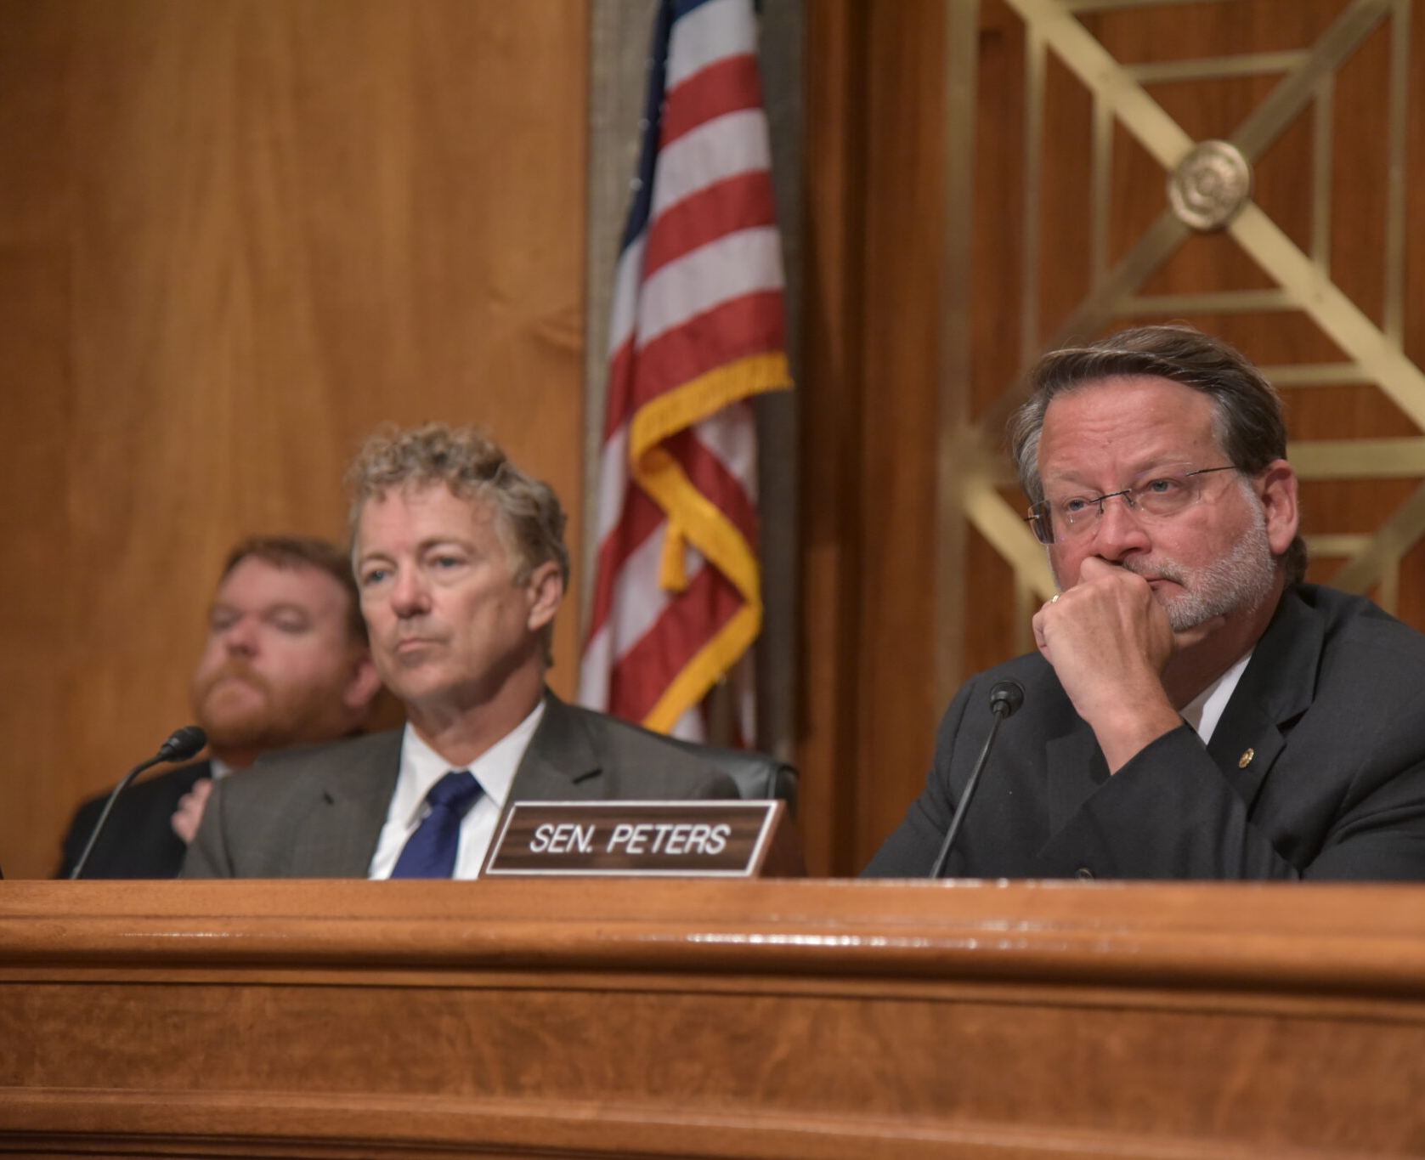
Supporting the Direct Care Workforce
Federal Legislation:
Standard Occupational Classification
Funding to support retention, recruitment, training
ARPA:
$37 B/ 50 states and DC
All states proposed activities to support workforce stability

Slide 7
Beneficiary Protections
Administrative action:
Final rule streamlining Medicaid enrollment/renewals
Final rule strengthening 504 of the Rehabilitation Act to prohibit discrimination and further meaningful community integration
Proposed rule to ban electrical stimulation devices as behavioral intervention
Encouraging addressing health related social needs through section 1115 waiver authorities

Slide 8
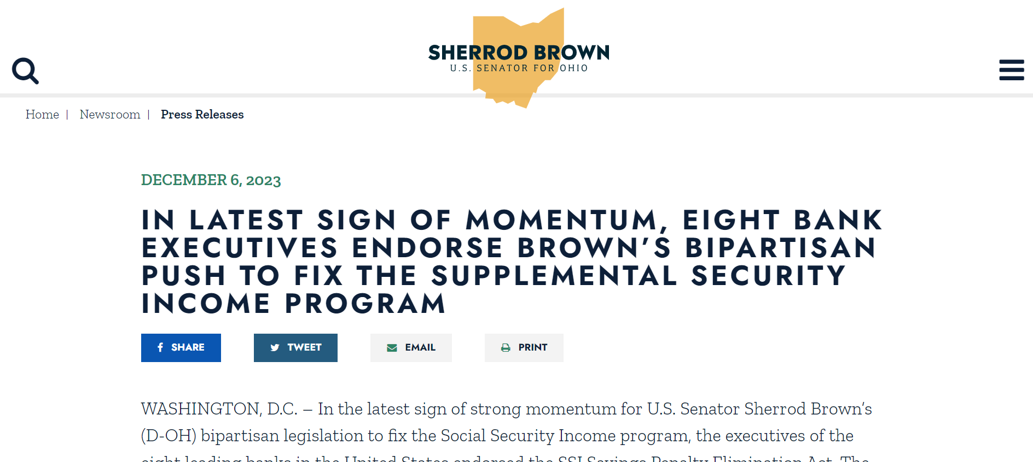
Beneficiary Protections
Legislation which seeks to address health related social needs and underlying barriers to access:
SSI Savings Penalty Elimination Act – Bipartisan legislation that would raise the SSI asset limitation from $2000 to $10,000/person

Slide 9
With federal policymaking focused on ways to strengthen access to services,
what is the impact of the resulting policies?

Slide 10
2024 Final Access Rule

Slide 11
Access Rule Toplines
Medicaid Advisory Committee and Beneficiary Advisory Council
Person Centered-Planning and Grievances
Incident Management System
HCBS Payment Adequacy (80/20)
HCBS Quality Measure Set
Access, Rates, and Waiting Lists
Reporting and Website

Slide 12
HCBS Payment Adequacy (6 years)
States must meet the following minimum performance level as applicable, calculated as the percentage of total payment (not including excluded costs) to a provider for furnishing homemaker, home health aide, or personal care services, as set forth at § 440.180(b)(2) through (4), represented by the provider’s total compensation to direct care workers.
[Other than exceptions], the State must ensure that each provider spends 80 percent of total payments the provider receives for services it furnishes [as described above] on total compensation for direct care workers who furnish [those services.]

Slide 14
2024 Final Overtime Rule

Slide 15
Increases the Standard Salary Threshold
Current Threshold | Beginning July 1, 2024 | Beginning January 1, 2025
$684 per week ($35,568 annually) | $844 per week ($43,888 annually) | $1,128 per week ($58,656 annually)

Slide 16
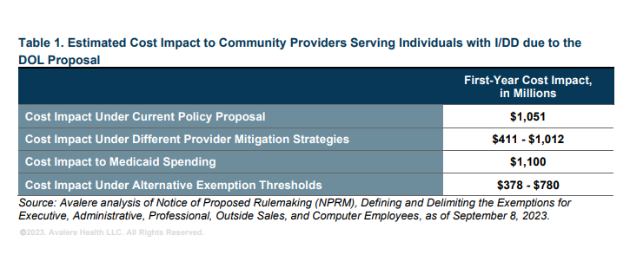
Impact to I/DD Providers and Services Based on Proposed Rule

Slide 17
Other Recent Rulemaking

Slide 18
Other Recent Rulemaking
Regulations/RFIs Impacting Providers and Services:
Advancing Interoperability and Improving Prior Authorization Processes
Employee or Independent Contractor Classification Under the Fair Labor Standards Act
Establishing a National Directory of Healthcare Providers & Services (RFI)
Section 504 Regulations
Managed Care Rules
Adult Protective Services Standards
Nursing Home Staffing Regulations (ICF Payment Transparency)
Revisions to 1915(c) Waiver Application and Technical Guide
SSI In-Kind Support and Maintenance Related Rules

Slide 19


Thank You!
Lydia Dawson (she/her)
Vice President, Government Relations
ANCOR
ldawson@ancor.org

