Slide 1
Extended Employment

Slide 2
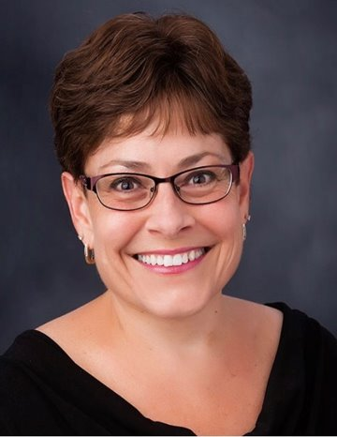
Extended Employment Team
Meghan Hanson
VRS EE Program Specialist
(651) 539-4152
Meghan.Hanson@state.mn.us
Lori Thorpe
VRS Director of Contracts & Partnerships
(651) 274-8880
Lori.Thorpe@state.mn.us

Slide 3
Updates
Compliance Audits
Forms on website updated
Hard deadline of October 31st
Monitor Visits
Every provider over next year
Rotate each year after
EE 101 Trainings
VRS Teams
EE Providers
BEN meetings

Slide 4
EE 101 Trainings
EE 101 Training key points
VRS as an Agency has 3 distinct programs
Vocational Rehabilitation Services
Extended Employment
Independent Living Skills
EE as a program has it’s own budget that comes from the General Fund and the Workforce Development Fund
There is no conflict between EE and VR services
The burden of EE compliance by providers fall on the EE Program Specialist, not VR staff.
The EE Rule dictates compliance for EE providers - 3300 - MN Rules Chapter

Slide 5
Find us online
Extended Employment - Long-Term Job Supports / Minnesota Department of Employment and Economic Development (mn.gov)

Slide 6
Questions
Please contact Meghan Hanson with any
EE questions you may have.
Meghan.Hanson@state.mn.us
(651) 895-3808

Slide 7
Thank You!

